Slide 1
Cómetelo
Kamalah Chang
Ironhack Data Analytics Bootcamp| CDMX | Septiembre 2020

Slide 2



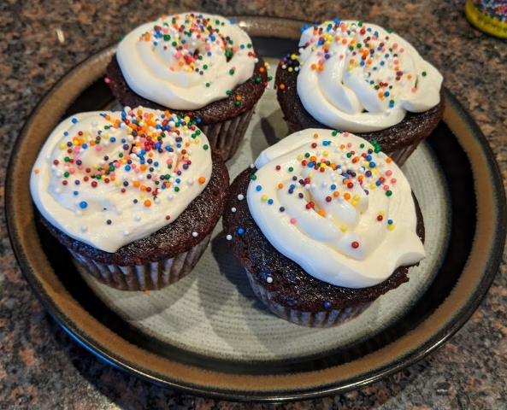


About Me
Mechanical Engineer from California, currently working for an oilfield services company in Texas.
I travel (27 countries and counting), run, and bake in my spare time
Notes:
Mi nombre es Kamalah Chang. Soy de California. yo Llevo 16 años trabajado para Schlumberger como ingeniero mecánico.
Disfruto corriendo, viajando y horneando en mi tiempo libre.

Slide 3
Problem Statement
What is the best recipe to make?
Highest rating?
Fewest ingredients?
Fewest steps?
Quickest?
What do the recipes have in common that makes them the highest rated?
Notes:
¿Calificación más alta?¿Menos ingredientes?¿Menos pasos?Más rápido

Slide 4
Approach
Get Data
Kaggle database:
180 K+ recipes and 700K+ recipe reviews covering 18 years of user interactions and uploads on Food.com
Develop Scoring algorithm
Return Top 5 Recipes
Develop GUI
Notes:
*Clustering*
Desarrollar algoritmo de puntuación
Agregar los Top 5 recetas
Desorollar el GUI

Slide 5
Technical Challenge | Defining the Top 5 algorithm
How to define the “exoticness” of an ingredient
Identify all ingredients in all recipes
Rate frequency of each ingredient for score most frequent ingredients.
Some recipes only have 5 reviews, some have 5000
Combine average rating and number of reviews into a single metric
The most frequent across all recipes!
salt
oil
butter
cheese
garlic
Notes:
Identificar todos los ingredientes en todas las recetas.
Califique la frecuencia de cada ingrediente para calificar los ingredientes más frecuentes.
Algunas recetas solo tienen 5 reseñas, algunas tienen 5000Combine la calificación promedio y el número de reseñas en una sola métrica

Slide 6
Add a Slide Title - 4
Git:Display a screenshot of your GitHub graphs to show your commit frequency and how much work you did.

Slide 7
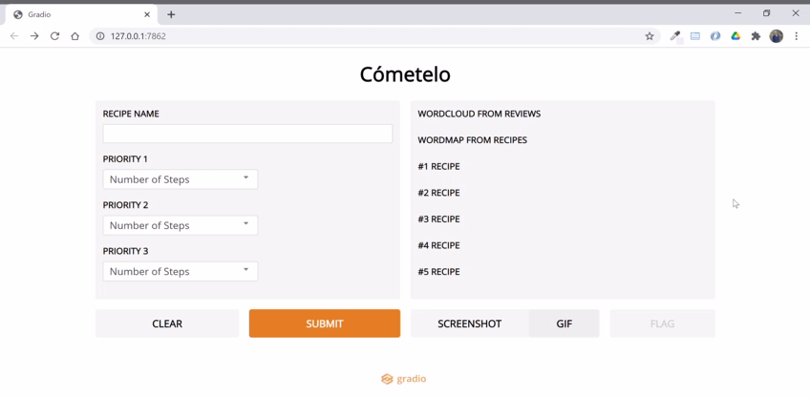
Demo

